Slide 1


OCP 11 Part 1 [1Z0-819]
Dr.-Ing Mohamed Amine Mezghich
Associate Professor at ENSI, CEO of Smart IT Partner
JAVA/J2EE Certified Trainer
ma.mezghich@smart-it-partner.com
amine.mezghich@ensi-uma.tn

Slide 2
Chapter 5:Class Design
OCA EXAM OBJECTIVES COVERED IN THIS CHAPTER: ✓ Working with Inheritance ■ Describe inheritance and its benefits ■ Develop code that demonstrates the use of polymorphism; including overriding and object type versus reference type ■ Determine when casting is necessary ■ Use super and this to access objects and constructors ■ Use abstract classes and interfaces

Slide 3
Chapter 5:Class Design
In Chapter 1, “Java Building Blocks,” we introduced the basic definition for a class in Java. In Chapter 4, “Methods and Encapsulation,” we delved into constructors, methods, and modifiers, and showed how you can use them to build more structured classes. In this chapter, we’ll take things one step further and show how class structure is one of the most powerful features in the Java language. At its core, proper Java class design is about code reusability, increased functionality, and standardization. For example, by creating a new class that extends an existing class, you may gain access to a slew of inherited primitives, objects, and methods. Alternatively, by designing a standard interface for your application, you ensure that any class that implements the interface has certain required methods defined. Finally, by creating abstract class definitions, you’re defining a platform that other developers can extend and build on top of.

Slide 4
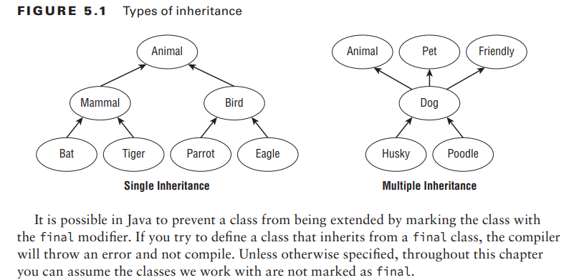
1-Introducing Class Inheritance

Slide 5
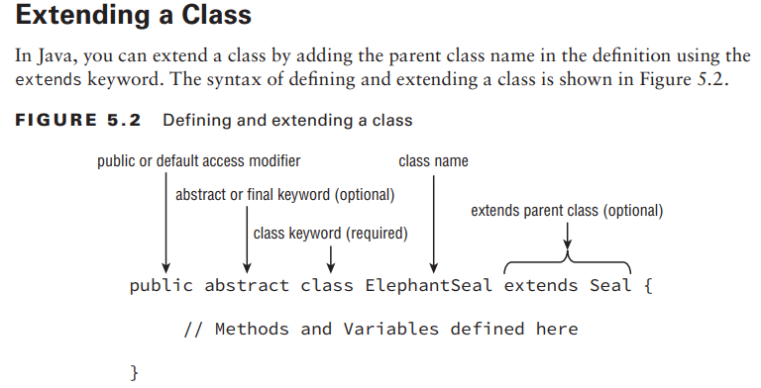
1-Introducing Class Inheritance

Slide 6
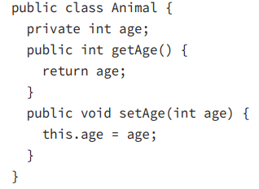
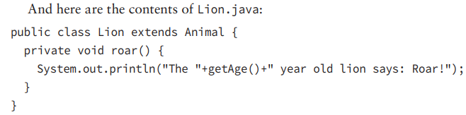
1-Introducing Class Inheritance
Because Java allows only one public class per file, we can create two files, Animal.java and Lion.java, in which the Lion class extends the Animal class. Assuming they are in the same package, an import statement is not required in Lion.java to access the Animal class. Here are the contents of Animal.java:

Slide 7
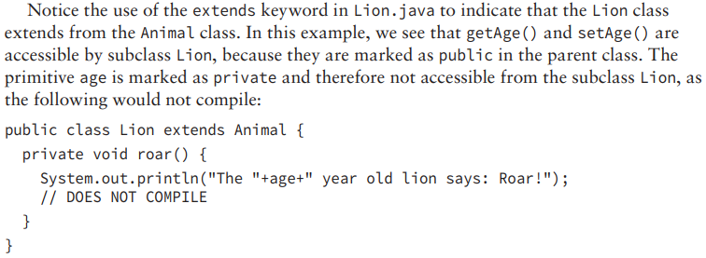
1-Introducing Class Inheritance

Slide 8
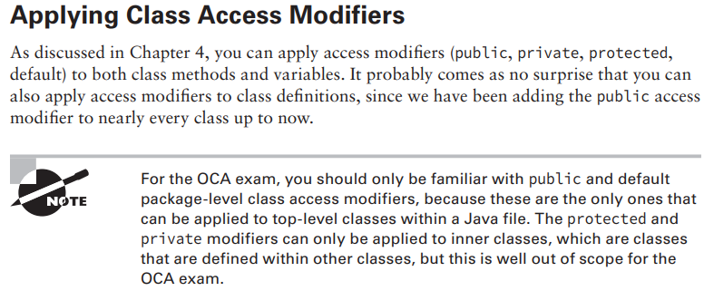
1-Introducing Class Inheritance

Slide 9
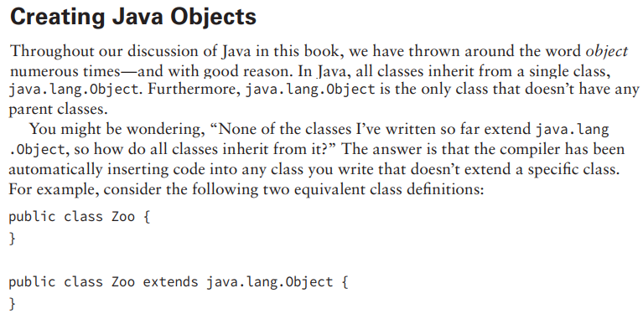
1-Introducing Class Inheritance

Slide 10
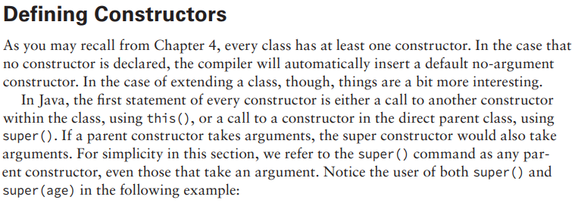
1-Introducing Class Inheritance

Slide 11
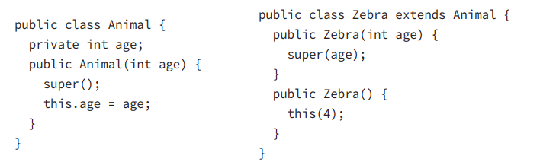
1-Introducing Class Inheritance

Slide 12
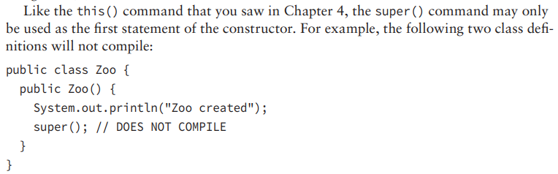
1-Introducing Class Inheritance

Slide 13
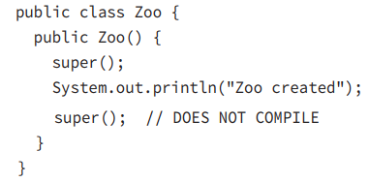
1-Introducing Class Inheritance

Slide 14
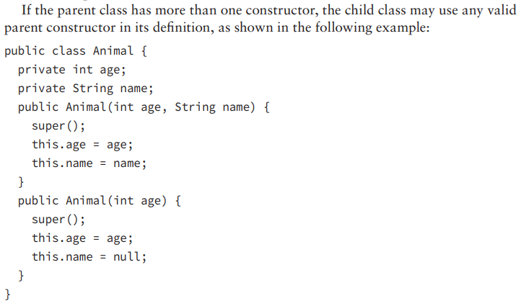
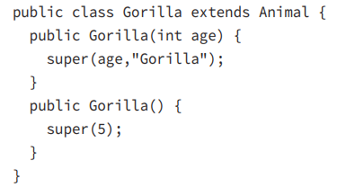
1-Introducing Class Inheritance

Slide 15
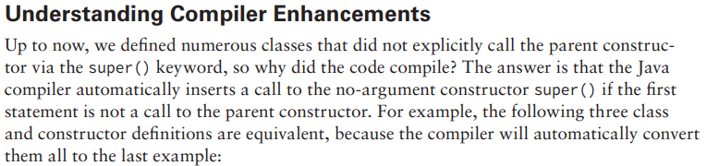
1-Introducing Class Inheritance

Slide 16
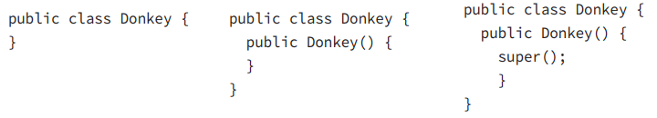
1-Introducing Class Inheritance

Slide 17
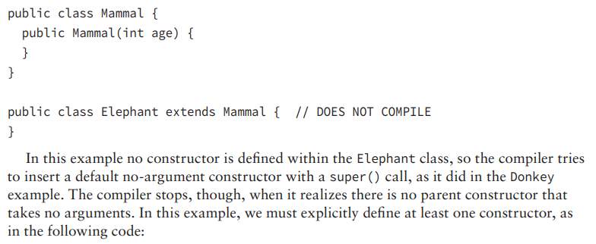
1-Introducing Class Inheritance

Slide 18
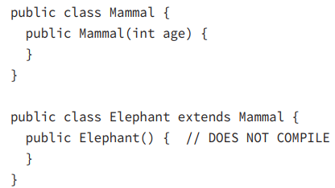
1-Introducing Class Inheritance

Slide 19
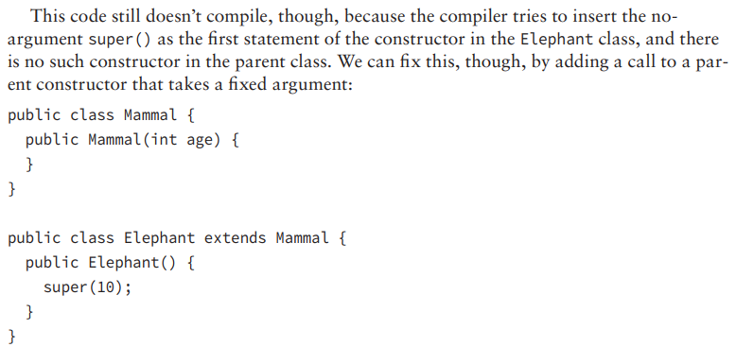
1-Introducing Class Inheritance

Slide 20
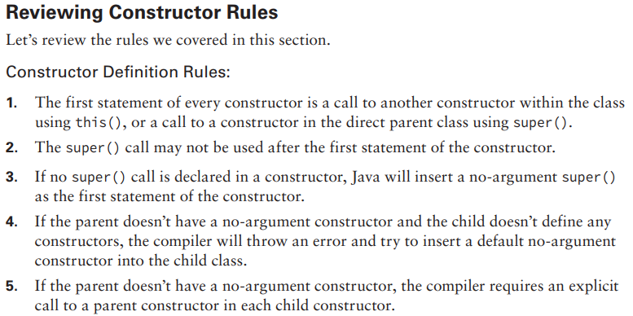
1-Introducing Class Inheritance

Slide 21
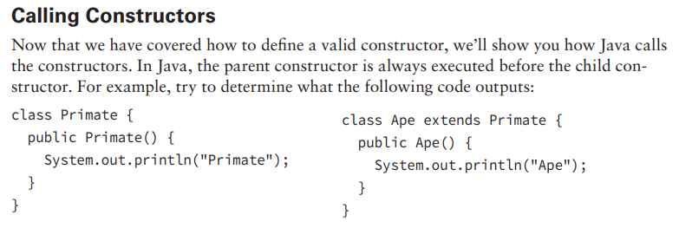
1-Introducing Class Inheritance

Slide 22
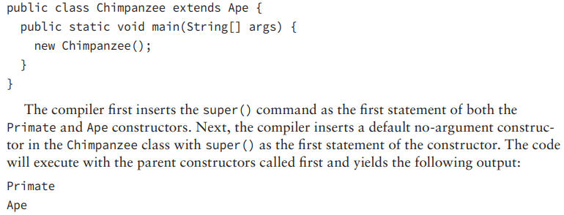
1-Introducing Class Inheritance

Slide 23
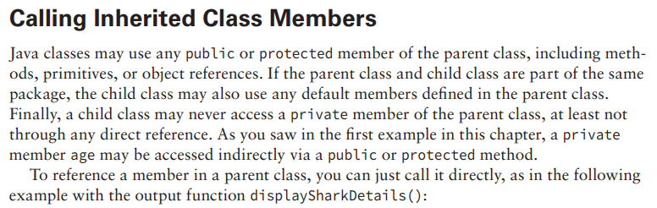
1-Introducing Class Inheritance

Slide 24
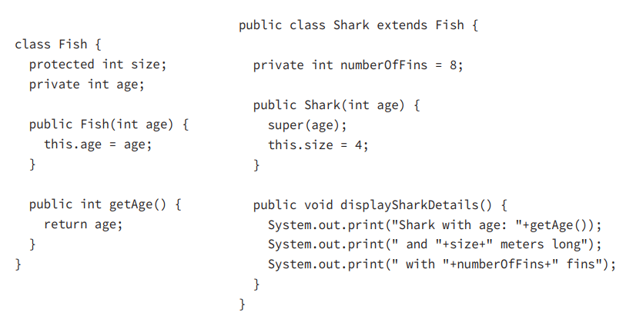
1-Introducing Class Inheritance

Slide 25
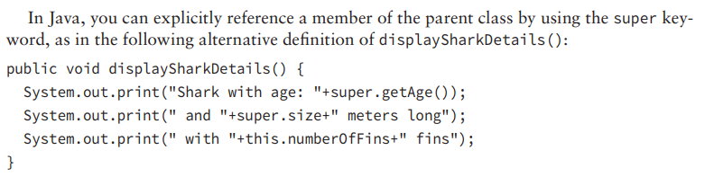
1-Introducing Class Inheritance

Slide 26
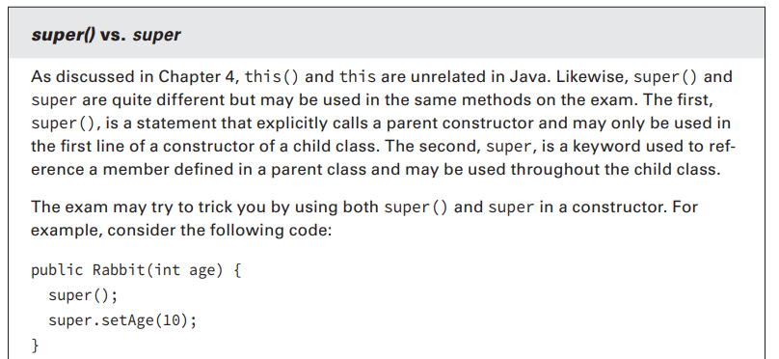
1-Introducing Class Inheritance

Slide 27
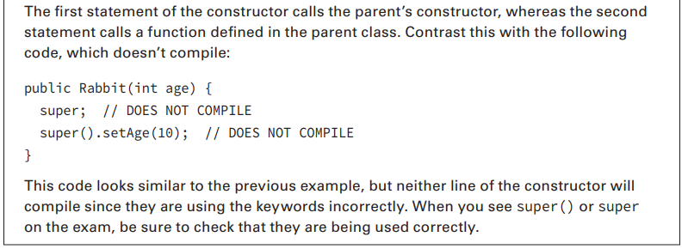
1-Introducing Class Inheritance

Slide 28
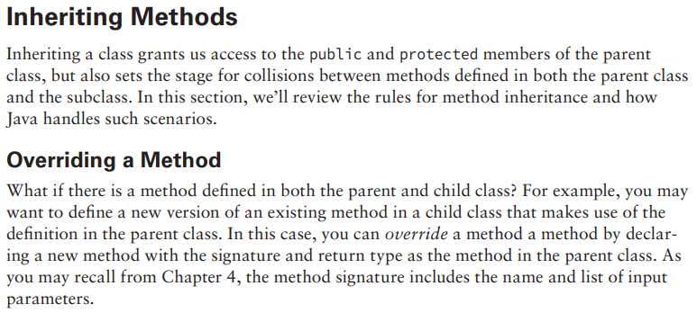
1-Introducing Class Inheritance

Slide 29
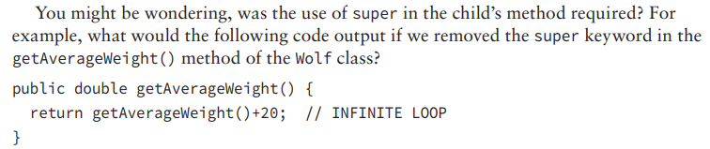
1-Introducing Class Inheritance

Slide 30
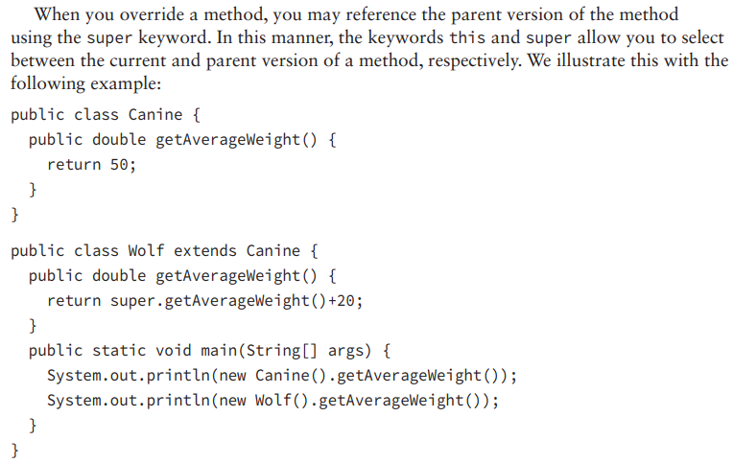
1-Introducing Class Inheritance

Slide 31
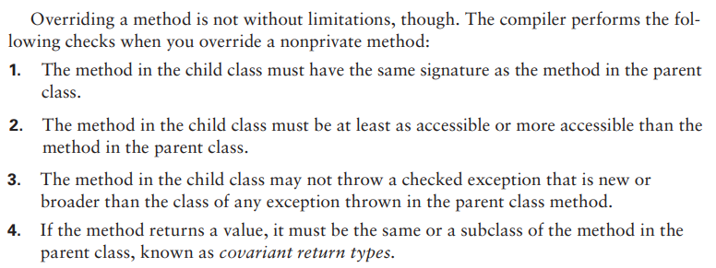
1-Introducing Class Inheritance

Slide 32
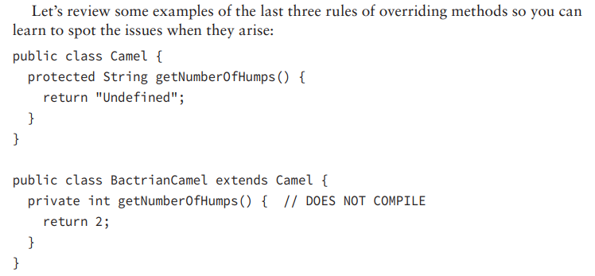
1-Introducing Class Inheritance

Slide 33
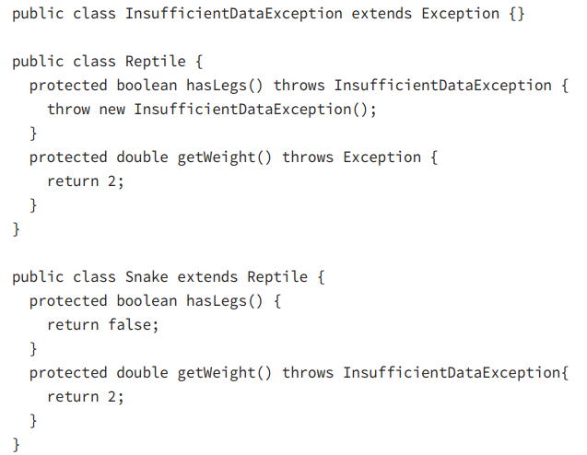
1-Introducing Class Inheritance

Slide 34
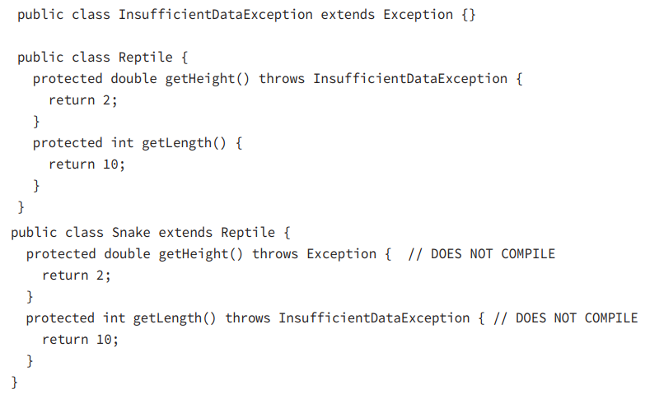
1-Introducing Class Inheritance

Slide 35
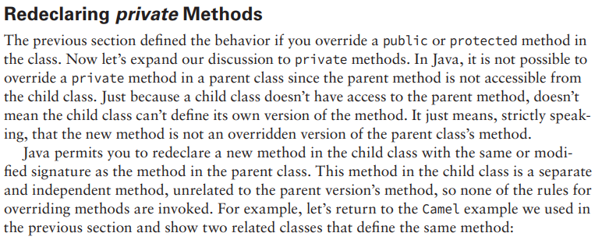
1-Introducing Class Inheritance

Slide 36
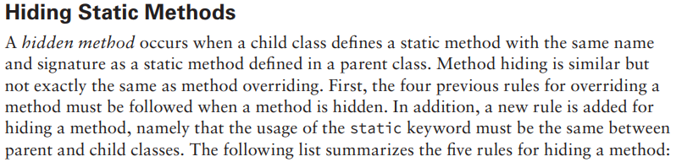
1-Introducing Class Inheritance

Slide 37
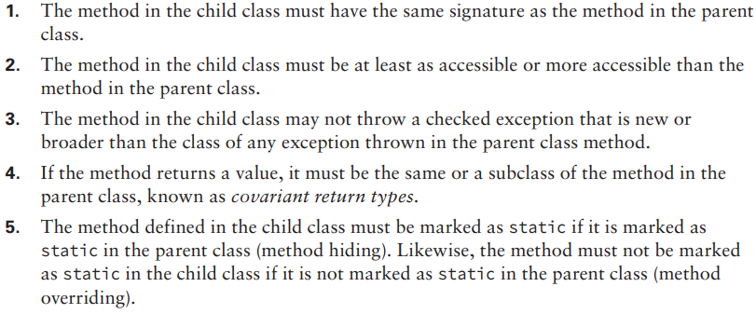
1-Introducing Class Inheritance

Slide 38
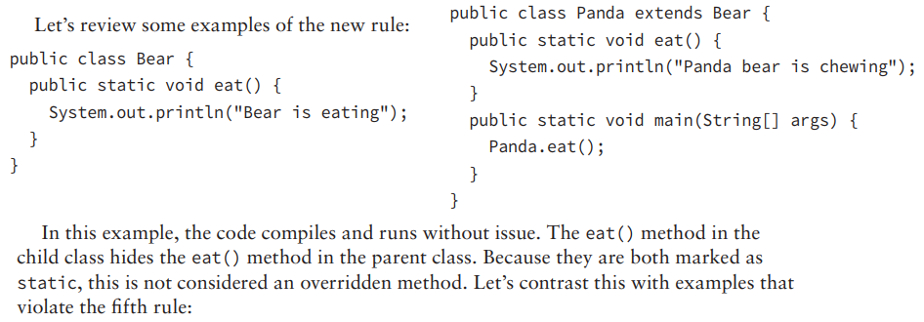
1-Introducing Class Inheritance

Slide 39
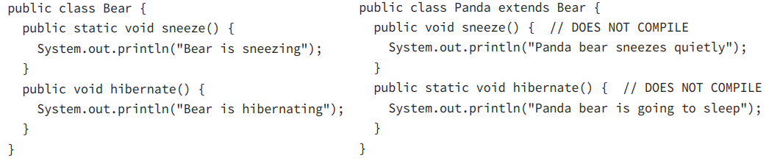
1-Introducing Class Inheritance

Slide 40
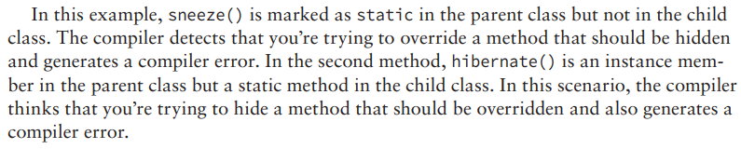
1-Introducing Class Inheritance

Slide 41
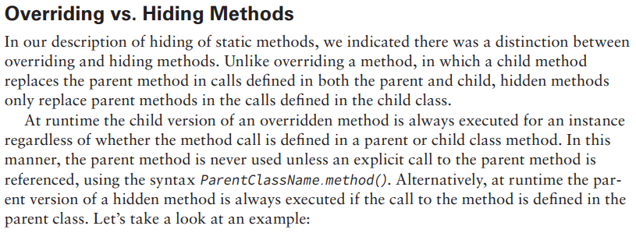
1-Introducing Class Inheritance

Slide 42
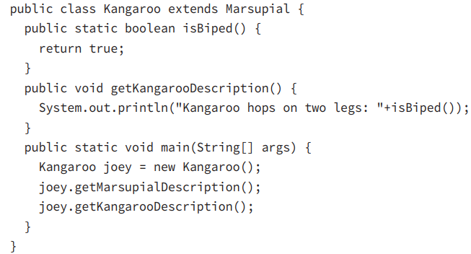
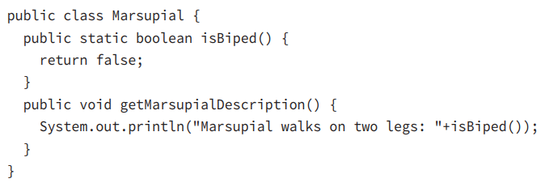
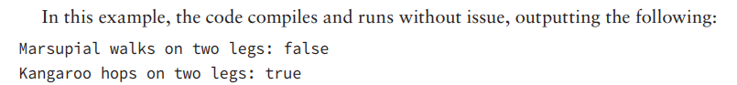
1-Introducing Class Inheritance

Slide 43
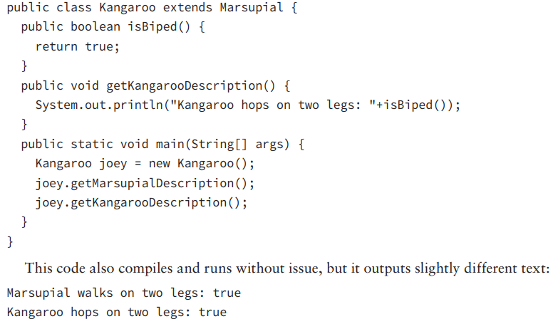
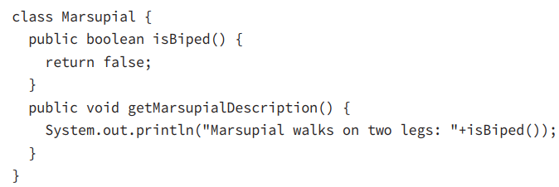
1-Introducing Class Inheritance

Slide 44
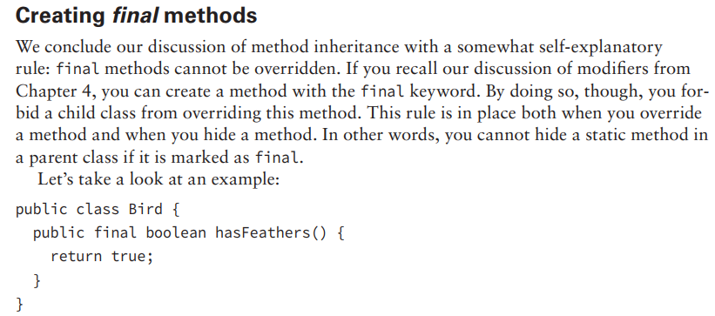
1-Introducing Class Inheritance

Slide 45
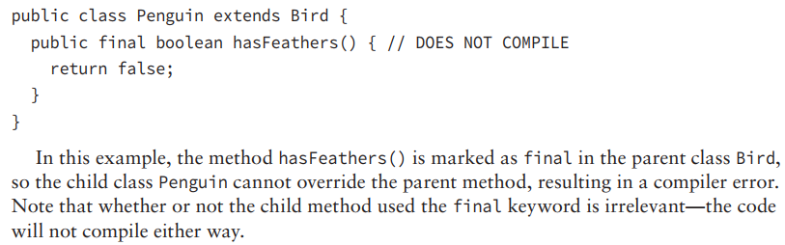
1-Introducing Class Inheritance

Slide 46
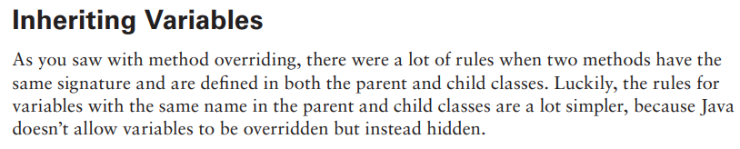
1-Introducing Class Inheritance

Slide 47
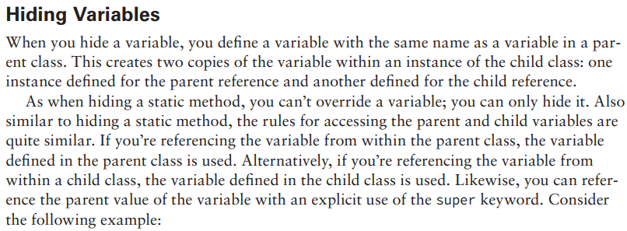
1-Introducing Class Inheritance

Slide 48
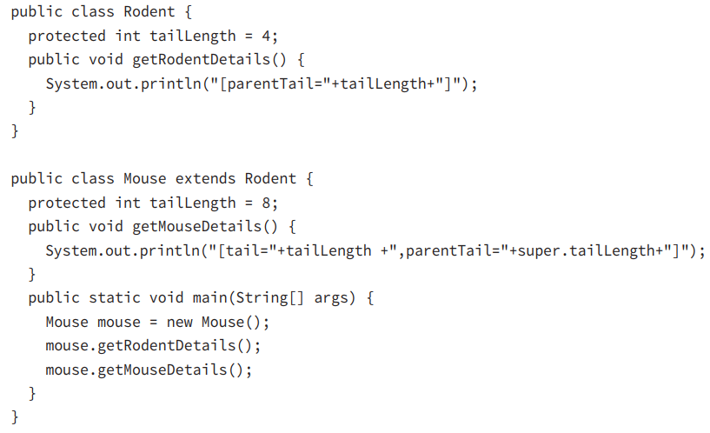

1-Introducing Class Inheritance

Slide 49


1-Introducing Class Inheritance

Slide 50


2-Creating Abstract Classes

Slide 51



2-Creating Abstract Classes

Slide 52


2-Creating Abstract Classes

Slide 53

2-Creating Abstract Classes

Slide 54

2-Creating Abstract Classes

Slide 55

2-Creating Abstract Classes

Slide 56

2-Creating Abstract Classes

Slide 57

3-Implementing Interfaces

Slide 58

3-Implementing Interfaces

Slide 59

3-Implementing Interfaces

Slide 60

3-Implementing Interfaces

Slide 61

3-Implementing Interfaces

Slide 62

3-Implementing Interfaces

Slide 63

3-Implementing Interfaces

Slide 64

3-Implementing Interfaces

Slide 65

3-Implementing Interfaces

Slide 66

3-Implementing Interfaces

Slide 67

3-Implementing Interfaces

Slide 68

3-Implementing Interfaces

Slide 69

3-Implementing Interfaces

Slide 70

3-Implementing Interfaces

Slide 71

3-Implementing Interfaces

Slide 72

3-Implementing Interfaces

Slide 73

3-Implementing Interfaces

Slide 74



3-Implementing Interfaces

Slide 75


4-Understanding Polymorphism

Slide 76


4-Understanding Polymorphism

Slide 77


4-Understanding Polymorphism

Slide 78

4-Understanding Polymorphism

Slide 79

4-Understanding Polymorphism

Slide 80

4-Understanding Polymorphism

Slide 81

4-Understanding Polymorphism

Slide 82

4-Understanding Polymorphism

Slide 83

4-Understanding Polymorphism

Slide 84

4-Understanding Polymorphism

Slide 85

4-Understanding Polymorphism

Slide 86

4-Understanding Polymorphism

Slide 87

4-Understanding Polymorphism

Slide 88

4-Understanding Polymorphism

Slide 89

4-Understanding Polymorphism

